Slide 1
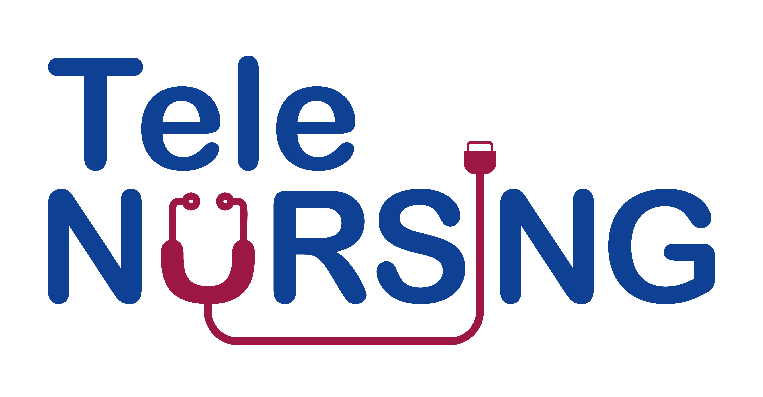
Module 1. Knowledge of Technology

Slide 2
Objectives
Patient Care and Monitoring: Training nurses in telecare technologies enables them to remotely monitor and assess patients' health conditions, vital signs, and adherence to treatment plans. This leads to more proactive and timely interventions, improving patient outcomes and reducing hospital readmissions.
Technology Proficiency: Telecare technologies can range from video conferencing platforms for virtual consultations to remote patient monitoring devices. Training helps nurses become comfortable and confident in using these tools, ensuring seamless integration into their daily workflow.
Patient Education and Support : Nurses can use telecare to provide health education materials, resources, and personalized guidance to patients, empowering them to actively participate in their care and self-management of chronic conditions.
Communication and Collaboration: Telecare training fosters effective communication and collaboration among healthcare professionals. Nurses can work closely with physicians, specialists, and other team members to discuss patient cases, treatment plans, and follow-up care.
Data Security and Privacy: Nurses need to be aware of the importance of data security and patient privacy when using telecare technologies. Training emphasizes adherence to confidentiality and compliance with relevant regulations to protect patient information.
Adapting to Changing Healthcare Landscape: Training prepares nurses to adapt to advancements in telecare technologies and stay updated with best practices in the rapidly evolving healthcare landscape.

Slide 3
Unit 1. Remote Patient monitoring

Slide 4
Aim
The aim of training nurses on Remote Patient Monitoring (RPM) is to equip them with the knowledge and skills necessary to effectively use technology and remote monitoring tools to support and care for patients who are not physically present in a healthcare facility or especially at a Place -of-Care away from a healthcare facility. RPM is a rapidly evolving field that leverages technology to monitor patients' health and vital signs from a distance, in their own homes

Slide 5
Objectives
Improve Patient Care
Enhance Patient Engagement
Reduce Healthcare Costs
Increase Access to Care
Enhance Data Collection and Analysis
Improve Quality of Life
Early Detection and Intervention
Population Health Management
Chronic Disease Management
Research and Continuous Improvemen

Slide 7
symptoms and conditions that can be tracked through remote patient monitoring
High blood pressure
Diabetes
Weight loss or gain
Heart conditions
Chronic obstructive pulmonary disease
Sleep apnea
Asthma

Slide 8
Benefits of patients using monitoring at-home
• Reduced hospitalizations
• Shorter hospital stays if the patient can be discharged with a remote monitoring device to use at home
• Fewer visits to the emergency room
• Better health outcomes for patients in rural areas
• Better preventative management for chronic conditions
• Reduced risk of illnesses for patients and health care workers.

Slide 9
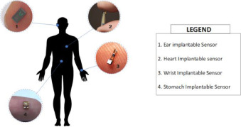
Types of sensors in RPMS
Fig. 1. Wearable Sensors used in RPMS.
Fig. 2. Implantable Sensors in RPMS.

Slide 10
Unit 2. Basic of Medical Informatics

Slide 11
Aim
The aim of training nurses in medical informatics is to equip them with the knowledge and skills necessary to effectively use and manage healthcare information technology and electronic health records (EHRs) in their clinical practice. Medical informatics, also known as health informatics, is a multidisciplinary field that focuses on the use of information technology and data to improve healthcare delivery, patient outcomes, and the overall quality of care.

Slide 12
Objectives
Efficient Data Management: Nurses learn how to input, access, and manage patient data in EHR systems, which streamlines the documentation process and reduces the risk of errors.
Improved Patient Care: Medical informatics training helps nurses make better-informed clinical decisions by providing access to patient histories, test results, and evidence-based guidelines.
Enhanced Communication: Nurses can use electronic systems to communicate with other healthcare providers and share important patient information more quickly and accurately.
Decision Support: Training enables nurses to utilize decision support tools and clinical decision support systems to aid in diagnosing and treating patients.
Quality and Safety: Proper use of medical informatics can lead to improved patient safety through error reduction, alerts for potential issues, and medication reconciliation.
Research and Data Analysis: Nurses can use informatics skills to participate in research projects, analyze healthcare data, and contribute to evidence-based practice.
Patient Engagement: Informatics training can empower nurses to engage patients in their own care by helping them access their health information and make informed decisions.
Compliance: Understanding health informatics ensures that nurses can adhere to regulatory requirements and maintain the security and privacy of patient data.
Interoperability: Training helps nurses navigate the interoperability of various health information systems and exchange data seamlessly.
Continuous Learning: As technology in healthcare evolves, nurses need ongoing training to stay updated and adapt to new tools and systems.

Slide 13
Medical Informatics in Telecare / Telemedicine
Data Management and EHRs (Electronic Health Records): Medical informatics helps in the creation and management of electronic health records (EHRs), which contain a patient's medical history, diagnoses, medications, and other relevant information. Diabetes
Remote Monitoring: Medical informatics facilitates the collection of patient data through various remote monitoring devices, such as wearable sensors, IoT (Internet of Things) devices, and mobile apps. Heart conditions
Teleconsultations: Telemedicine platforms use medical informatics to enable secure video and audio consultations between healthcare providers and patients.
Decision Support and telehealth Analytics: Medical informatics systems often include decision support tools that help healthcare providers make informed decisions during teleconsultations.
Telepathology: Telepathology allows pathologists and other healthcare professionals to remotely review and consult on pathology specimens, such as tissue biopsies and slides.
Teletriage: Telemedicine services are often integrated with medical informatics to provide remote triage and assessment of patient conditions, helping determine the urgency of care required and directing patients to appropriate levels of care.

Slide 14
Soft skills that professionals need
• Analytical Thinking Skills. Health informatics specialists work with and analyze complex data sets. This requires technical competency and a keen understanding of how trends and patterns can drive decision-making. Informaticists use analytical thinking skills every time they glean insights from electronic medical records or insurance claim data and then weave those insights into a compelling narrative for stakeholders.
• Communication Skills. Research shows that effective communication has a positive effect on organizational performance. Health informatics specialists bridge the gap between highly technical clinical data analysis and health care system leadership. Strong communication skills let professionals in this field break down complex data concepts to an audience who may not be technologically savvy.
• Curiosity and Drive. Health informatics specialists work in various business and clinical health care settings (e.g., hospitals, specialty clinics, insurance companies and health IT firms). To thrive in all of them, informaticists must commit to lifelong learning because technology and health care evolve rapidly.
• Ethics. Health informatics professionals work closely with confidential patient data, so they must operate ethically. Health information management in the age of Big Data poses new ethical problems related to “patient-facing tools, mobile devices, social media, privacy inclusivity, and e-consent.”
• Organization. Health informatics specialists often engage with massive data sets and work on large projects that can impact patients, health care providers and health care systems. Their approach to health data management must be meticulous to ensure patient data stays private and secure and that organizations comply with all relevant regulations.
• Problem-Solving. Problem-solving is one of the primary duties of health informatics specialists, who use clinical or operational data to identify challenges and actionable solutions in health care settings.

Slide 15
Types of sensors in RPMS
Fig. 3. CarePOI Medical Folder

Slide 16
Unit 3. Diagnostic Equipment

Slide 17
Aim
Diagnostic devices play a crucial role in telecare and telemedicine, especially in community care settings, by enabling healthcare professionals like nurses to remotely monitor and assess patients' health conditions. Telecare using diagnostic devices can bring healthcare to underserved or remote communities, making healthcare more accessible to those who may have limited access to traditional healthcare facilities. Nurses can efficiently manage a larger number of patients using remote monitoring and diagnostic devices, as they can focus on patients who require immediate attention while keeping an eye on others through remote data analysis

Slide 18
Objectives
Training and Education: Nurses need to be trained in using the various diagnostic equipment and technologies used in telecare/telemedicine. They should understand how to operate the equipment, interpret results, and troubleshoot any issues.
Quality Care Delivery: By ensuring nurses are proficient with the diagnostic equipment, healthcare providers can maintain the quality of care they deliver to remote patients. Proper use of equipment can lead to accurate assessments and timely interventions.
Patient Safety: Competent use of diagnostic equipment is vital for patient safety. Nurses must know how to use the equipment correctly to prevent harm or errors in patient assessment and treatment.
Data Collection and Transmission: Nurses should understand how to collect patient data using diagnostic tools and transmit it securely to healthcare providers. This includes knowledge of data privacy and security practices.
Efficiency and Effectiveness: Proper training in using diagnostic equipment can improve the efficiency and effectiveness of nursing care in telemedicine. Nurses can make better decisions and provide more targeted interventions.
Communication Skills: Nurses may need to guide patients in using certain diagnostic tools remotely. Educating nurses on effective communication with patients regarding equipment usage is essential.
Compliance and Regulations: Understanding the regulatory and compliance requirements related to telemedicine and diagnostic equipment is crucial. Nurses need to be aware of legal and ethical considerations when using these tools.
Troubleshooting and Maintenance: Nurses should be able to troubleshoot common issues with the equipment and perform basic maintenance tasks to ensure its functionality.
Collaboration: Nurses often work as part of a team in telecare/telemedicine settings. Knowing how to use diagnostic equipment allows them to collaborate effectively with other healthcare professionals.
Adaptation to Technological Advances: Technology in healthcare is constantly evolving. Regular training and updates on new equipment and tools help nurses adapt to the latest advancements.

Slide 19
Diagnostic Tools
Digital Stethoscopes: Digital stethoscopes are used to auscultate and transmit heart and lung sounds to healthcare providers remotely. They often come with Bluetooth capabilities for easy data transfer.
Remote Monitoring Devices: These include various wearable devices and sensors that can monitor vital signs and health parameters. Examples include:
Blood Pressure Monitors: These devices measure a patient's blood pressure and can transmit the data to healthcare providers.
Pulse Oximeters: Used to measure blood oxygen levels and pulse rate.
Glucose Monitors: Devices for monitoring blood glucose levels, essential for diabetes management.
Wearable ECG Monitors: These devices can record and transmit electrocardiogram (ECG) data, enabling remote cardiac monitoring.
Remote Spirometers: These devices are used to measure lung function and are especially important for patients with respiratory conditions like asthma or COPD.
Telemedicine Carts: These are mobile units equipped with various diagnostic tools, including cameras, otoscopes, and examination cameras. They are often used in clinical settings for more comprehensive remote examinations.
Dermatoscopes: Used in teledermatology to examine skin lesions and transmit high-quality images for remote diagnosis.
Digital Imaging Equipment: Such as digital X-ray machines and ultrasound devices that can transmit images and data for remote interpretation by specialists.
Tele-ophthalmology Equipment: This includes digital retinal cameras and optical coherence tomography (OCT) machines for remote eye exams.
Video Conferencing Systems: High-quality video conferencing systems with high-resolution cameras and screens, which are critical for remote visual examinations.
Smartphones and Tablets: These devices are often used by patients to connect with healthcare providers and to share real-time information, images, or videos of their symptoms.
Artificial Intelligence (AI) and Machine Learning Tools: AI-based diagnostic tools that can analyze medical data, images, and patient history to assist healthcare providers in making diagnoses and treatment recommendations.

Slide 20
Types of sensors in RPMS

Slide 21
Unit 4. Telemedicιne and TeleCare

Slide 22
Telemedicine
Telemedicine utilizes information and telecommunications technology to transfer medical information for diagnosis, therapy and education. The medical information may include images, live video and audio, video and sound files, patient medical records, and output data from medical devices. The transfer may involve interactive video and audio communication between patients and medical professionals, or between those professionals without patient participation. Alternatively, it may simply describe the transmission of patient data either from monitoring devices (telemetry) or from medical histories (electronic patient records). Those taking part in the transfer may be located in a GP surgery, a hospital clinic or some other environment if the occasion is an emergency .

Slide 23
Telehealth
Telehealth is the use of information and communication technologies to transfer healthcare information for the delivery of clinical, administrative and educational services. Extension to include administrative healthcare information recognizes the use of telematic services to transfer demographic and operational information that may have little or no clinical content. Similarly, while distance learning courses for healthcare professionals are covered by the banner of telehealth, components of these courses may concentrate on health policy or other non-clinical topics. In contrast, the term telecare is often used to describe the application of telemedicine to deliver medical services to patients in their own homes or supervised institutions. Telecare: Telecare utilizes information and communication technologies to transfer medical information for the diagnosis and therapy of patients in their place of domicile.

Slide 24
Aim
Monitoring mental conditions through telecare involves the use of technology to collect and transmit relevant data about an individual's mental health remotely. This approach can be particularly beneficial for continuous and real-time monitoring, especially in situations where regular in-person visits may be challenging.
• Data Collection:
Wearable Devices: Individuals may use wearable devices, such as smartwatches or fitness trackers, equipped with sensors to monitor various physiological indicators like heart rate, sleep patterns, and activity levels.
Mobile Apps: Specialized applications may be employed to gather self-reported data, mood tracking, medication adherence, and other relevant information directly from the individual.
Virtual Assessments: Teleconsultations can be utilized for virtual assessments and consultations with mental health professionals.
• Alerts and Notifications:
Automated Alerts: Algorithms can be designed to detect significant changes or deviations from baseline data. Automated alerts are then generated to notify healthcare providers, caregivers, or the individuals themselves.
Customizable Thresholds: Thresholds for various parameters can be set based on an individual's baseline and the specific requirements of their mental health treatment plan.
Communication and Feedback:
Telecommunication: Regular virtual check-ins or therapy sessions can be conducted through video calls, allowing mental health professionals to interact with their clients remotely.

Slide 25
Objectives
Monitoring mental conditions through telecare involves the use of technology to collect and transmit relevant data about an individual's mental health remotely. This approach can be particularly beneficial for continuous and real-time monitoring, especially in situations where regular in-person visits may be challenging.
• Data Collection:
Wearable Devices: Individuals may use wearable devices, such as smartwatches or fitness trackers, equipped with sensors to monitor various physiological indicators like heart rate, sleep patterns, and activity levels.
Mobile Apps: Specialized applications may be employed to gather self-reported data, mood tracking, medication adherence, and other relevant information directly from the individual.
Virtual Assessments: Teleconsultations can be utilized for virtual assessments and consultations with mental health professionals.
• Alerts and Notifications:
Automated Alerts: Algorithms can be designed to detect significant changes or deviations from baseline data. Automated alerts are then generated to notify healthcare providers, caregivers, or the individuals themselves.
Customizable Thresholds: Thresholds for various parameters can be set based on an individual's baseline and the specific requirements of their mental health treatment plan.
Communication and Feedback:
Telecommunication: Regular virtual check-ins or therapy sessions can be conducted through video calls, allowing mental health professionals to interact with their clients remotely.

Slide 26
Types of Telemedicine
• teleconsultation;
• tele-education;
• telemonitoring;
• telesurgery

Slide 27
Benefits of Telemedicine
• better access to healthcare;
• access to better healthcare;
• improved communication between careers;
• easier and better continuing education;
• better access to information;
• better resource utilization;
• reduced costs.

Slide 28
Limitations of Telemedicine
• telecommunications infrastructure and standards;
• cost effectiveness;
• national policy and strategy;
• ethical and legal aspects

Slide 29
Benefits and Limitations of Telemedicine

Slide 30
Data Security
Encryption
Access Control
Data Integrity
Data Storage and Retention
Secure Communication
Data Minimization
Compliance with Regulations
Secure Devices
Employee Training
Data Breach Response Plan
Vendor Assessment
Regular Audits and Assessments
Consent and Patient Education

