Slide 1
Module 2. TELE-COMMUNICATION SKILLS

Slide 2
The general aim of this course is to empower telenurses and healthcare practitioners with the knowledge and skills necessary to deliver effective and safe care through telehealth platforms. Participants will gain a deep understanding of communication strategies, the challenges and barriers associated with telehealth, and the vital aspects of patient assessment and monitoring in a remote setting. By addressing these core areas, this course aims to enhance the quality of care provided through telehealth services.

Slide 3
2.1 ACTIVE LISTENING, REFLECTIVE LISTENING, AND EMPATHIC LISTENING Definition
Active listening is the practice of preparing to listen, observing what verbal and non-verbal messages are being sent, and then providing appropriate feedback for the sake of showing attentiveness to the message being presented
Reflective listening is a special type of listening that involves paying respectful attention to the content and feeling expressed in another persons’ communication. Reflective listening is hearing and understanding, and then letting the other know that he or she is being heard and understood.
Empathy is the ability to understand and share other people’s feelings. It is a core concept as, according to the psychodynamic, behavioral and person-centered approaches, it facilitates the development of a therapeutic relationship with the health care user, providing the basis for therapeutic change.

Slide 4
What are benefits of active listening in healthcare
It eases fear and anxiety
It earns trust and boosts confidence
It lessens the incidence of misunderstandings
It enables better care
It provides for improved medical outcomes
(Ronald B. Adler, George Rodman, Athena du Pre, Understanding Human Communication 13th Edition, Oxford university press 2017)

Slide 5
Active listening methods
Relaying what was said back to the speaker to show that you understand how he/she feels about something.
Reflecting
Clarifying
Paraphrasing
Restate the same information, using different words to more concisely reflect what the speaker said.
Tests your understanding of what is heard by communicating your understanding of what the speaker said. Allows the speaker to 'hear' and focus on his or her own thoughts. Allows the speaker to see that you are trying to understand his/her message and perceptions. Encourages the speaker to continue speaking
Invite the speaker to explain some aspect of what she or he said
Gives the speaker the opportunity to elaborate and clarify what was said. Gives you the opportunity to identify anything that is unclear and to check the accuracy of your understanding
Helps both listener and speaker identify what is most important to the speaker
Summarizing
Identify, connect, and integrate key ideas and feelings in what the speaker said.
Helps both listener and speaker identify what is most important to the speaker

Slide 6
Effective Communication in Healthcare
Understanding the importance of putting yourself in the patient's shoes during healthcare communication is vital. It's not about avoiding patient interactions or improving paperwork efficiency. Instead, it's about enhancing your understanding of the patient's perspective, emotions, and concerns. Empathy is a crucial element of effective communication in healthcare, allowing providers to tailor their approach and provide more compassionate and patient-centered care
Improving communication in healthcare involves adopting key tips that contribute to a positive patient-provider interaction. It's not about avoiding eye contact or making assumptions about what the patient is feeling. Instead, using open-ended questions to encourage patients to share more is a crucial aspect of effective communication. This approach facilitates meaningful conversations, allowing healthcare providers to gather comprehensive information and provide personalized care.

Slide 7
Tips for better communication (Lucy Webb, Nursing: communications skills in practice)
Put Yourself in Their Shoes
Eye Contact
Open Questions
Validate feelings
Cultural
sensitivity
Empathy
Nonverbal cues
Don't make assumptions
Listen Actively
Respect
Reflect
Educate
ACTIVE LISTENING

Slide 8
2.1 COMMUNICATION USING TECHNOLOGY – CHALLENGES AND BARRIERS
Communication in telenursing, while valuable and convenient, can present several challenges and barriers that need to be addressed to ensure effective healthcare delivery.
Some of these challenges and barriers include:
Lack of Non-Verbal Cues
Technical Issues
Limited Physical Examination
Privacy and Security Concerns
Language and Cultural Barriers
Limited Access to Technology
Distractions and Environment
Loss of Personal Connection
Misinterpretation of Information
Legal and Regulatory Challenges
Patient Engagement:
Emergency Situations
Time Management
Training and Education

Slide 9
Generational, cultural, and socioeconomic factors in communication
Generational Challenges:
Technology Literacy
• Telenurses need to be patient and adapt their communication to accommodate varying levels of technology literacy.
Communication Preferences
• Telenurses should be flexible and capable of adapting their communication style to meet the patient's preferences.
Respect for Tradition and Values
•Encourage telenurses to ask open-ended questions to understand the patient's values and preferences

Slide 10
Cultural Challenges:
Language Barriers
Telenurses should have access to interpreter services when needed and use plain language when communicating with patients who may not be fluent in the language
Cultural Beliefs and Practices
• Cultural beliefs and practices can influence health behaviors and treatment preferences. Telenurses need to be aware of these factors to provide culturally sensitive care.
Non-Verbal Communication
• Different cultures may interpret non-verbal cues differently
• Telenurses should be cautious about misinterpretations and ask for clarification when necessary

Slide 11
Socioeconomic Challenges:
Access to Technology:
• Telenurses should be aware of these disparities and collaborate with patients to find solutions, such as alternative communication methods or community resources
Health Insurance and Affordability:
• Telenurses should provide information on available resources, government assistance programs, and low-cost healthcare options to help patients access necessary care
Health Literacy:
• Telenurses should use plain language, visual aids, and repeat important information to ensure comprehension

Slide 12
Strategies for overcoming telenursing communication challenges:
1. Using Plain Language and Avoiding Medical Jargon
2. Active Listening Skills
3. Building Rapport and Trust Remotely
4. Ensuring Patient Privacy and Confidentiality
5. Providing Clear Instructions for Using Telehealth Tools

Slide 13
2.3 SAFETY AND PRIVACY IN TELENURSING
The challenges and impacts related to telehealth security and privacy can be categorized into three key factors: environmental factors, technology factors, and operational factors.
Environmental Factors: These encompass an individual's surroundings, living conditions, and social connections, all of which can have direct or indirect implications for privacy and security.
Technology Factors: These factors encompass various data security issues, such as the potential for hacking during video visits, limited access to the internet and technology, the absence of digital devices, reliance on cellular data or public Wi-Fi, and insufficient digital literacy.
Operational Factors: These factors involve aspects such as reimbursement for telehealth services, monitoring payer denials for services, ensuring that telehealth technology is accessible to all patients, and providing adequate training and education for staff and providers.

Slide 14
Best Practices for Telehealth Privacy and Security
Developing best practices for telehealth privacy and security requires a comprehensive approach that addresses environmental, technology, and operational factors.
Best Practices for Telehealth Privacy and Security:
Protecting Patients' Telehealth Privacy
Sharing Secured Information Online
Building Privacy and Security Standards
Ensuring Reimbursement for Telehealth Services
As telehealth continues to evolve, health information professionals must address technology, digital literacy, and accessibility issues to ensure the successful and secure use of telehealth services for both patients and providers. Implementing best practice guidelines and policies is essential to meet the needs of all stakeholders effectively.

Slide 15
The Importance of Informed Consent in Telenursing
Informed consent, in the context of telenursing, is of paramount importance, and here's why:
Respect for Patient Autonomy
Understanding of the Process
Disclosure of Risks and Benefits
Protection of Privacy and Confidentiality
Legal and Ethical Compliance
Quality of Care
Documentation and Accountability
Informed consent in telenursing is not merely a procedural formality; it is a fundamental ethical and legal practice that upholds patient autonomy, fosters transparency, ensures privacy and security, and enhances the quality of care delivered through telehealth technology.

Slide 16
2.4 TELE-TRIAGE
Triage is the process of determining treatment priorities for patients based on the severity of their medical condition, with the goal of identifying patients with life-threatening conditions and providing them with timely medical care
The role of triage is to establish the patient's primary complaint, decide on the urgency of the patient's condition, assess the time to the start of the first physician examination, and initiate treatment.
Tele-triage is similar to traditional triage in an emergency department but uses technology that alters the live interaction between the patient and medical staff

Slide 17
Tele-triage can be conducted in the following ways:
Through a website or application where patients input their symptoms. Based on the provided information, the patient receives instructions on the next steps – whether it is necessary to go to the hospital or if visiting their family doctor is sufficient.
Through a phone call or video call – the patient discusses their symptoms with medical staff via a phone call or video call. The medical staff guides them on further actions.
Every tele-triage should begin with the completion of a form on the website or through an application. After the medical staff assesses the urgency and condition of the patient, it can be further communicated through a phone call or video call.
During the phone call or video call, medical staff should evaluate whether the patient requires further urgent medical care. In this form of communication, special attention should be paid to the patient's feelings and nonverbal communication, including breathing, gaze, hand movements, and body gestures.

Slide 18
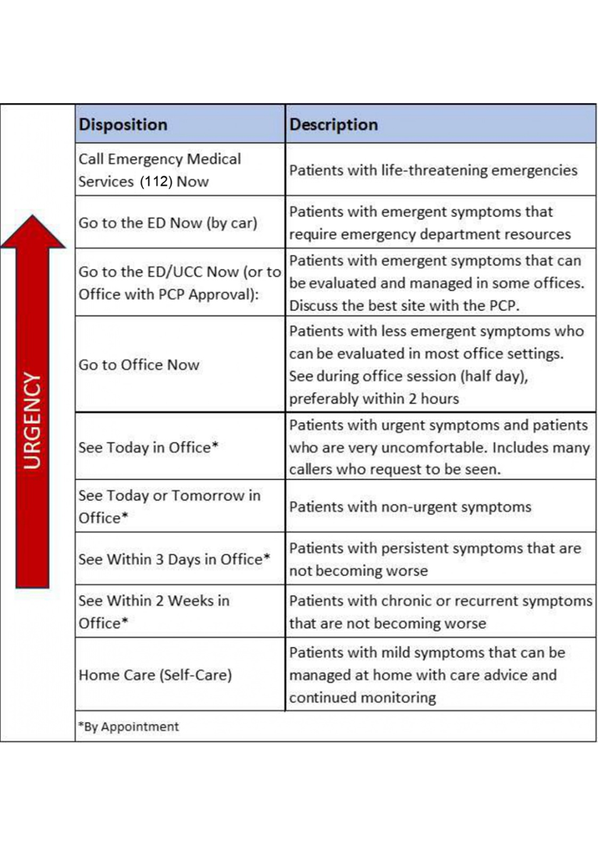
Every tele-triage should follow a protocol and assess the urgency of the patient's condition during triage

Slide 19
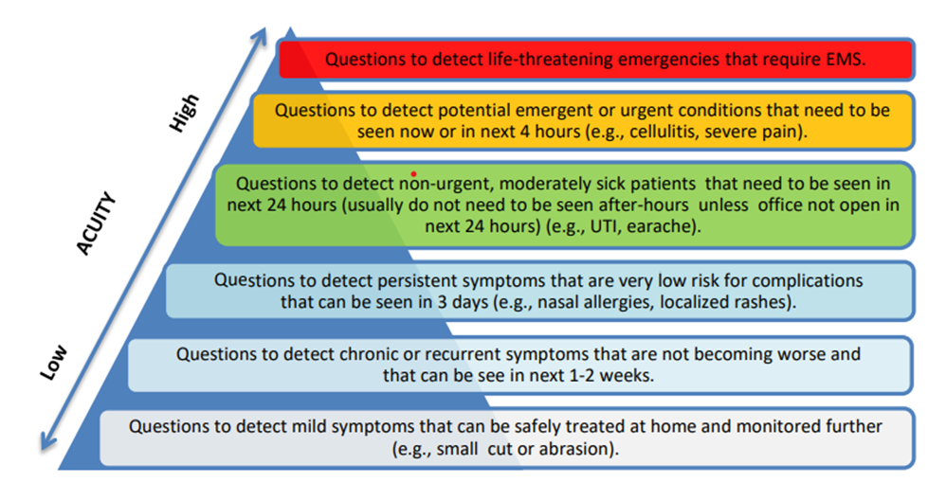
Questions that medical staff must ask during tele - triage

Slide 20
2.5 TELEHEALTH ENROLLMENT AND PATIENT ASSESSMENT
The challenge in using telemedicine services often lies in assessing an individual's ability and capacity to utilize such technology.
The primary barrier to the adoption of telemedicine is undoubtedly older individuals who encounter difficulties in navigating modern technologies such as smart phones, computers, or tablets.
Additionally, issues may arise from the telecommunications infrastructure upon which the availability and strength of the internet signal depend.
Many individuals lack access to technology such as smart phones and reliable broadband internet.

Slide 21
Important thing before the consultation is engage in phone outreach to patients prior to scheduled telehealth appointments to confirm their ability to attend.
Telemedicine should be made accessible to all individuals, including those who are digitally literate and those who are not, individuals with disabilities, as well as those who are blind or deaf
Important thing before the consultation is engage in phone outreach to patients prior to scheduled telehealth appointments to confirm their ability to attend
The important thing before the consultation with medical staff is send materials and assess patient accessibility and technology needs before the consultation. Include a way for patients to specify any special requirements when scheduling the consultation or via an intake form ahead of their virtual appointment

Slide 22
Provide resources in various formats, including printed materials, audio recordings, or Braille. Ensure that your website and online tools are accessible.
During appointments, effective communication and accommodation for diverse needs are essential, and patients should receive resources for follow-up care.
Telemedicine offers efficiency, accessibility, and chronic condition management benefits, with various scheduling options. By addressing the digital divide, providers can ensure equitable telehealth access.

Slide 23
Bibliography
Lucy Webb, Nursing: communications skills in practice, Oxford university press 2011
Timothy M. Hale, PhD and Joseph C. Kvedar, MD, Privacy and Security Concerns in Telehealth, https://journalofethics.ama-assn.org/article/privacy-and-security-concerns-telehealth/2014-12
Ronald B. Adler, George Rodman, Athena du Pre, Understanding Human Communication 13th Edition, Oxford university press 2017
Maria Moudatsou, Areti Stavropoulou, Anastas Philalithis, Sofia Koukouli, The Role of Empathy in Health and Social Care Professionals, Healthcare (Basel). 2020 Mar; 8(1): 26.
Roya Hakimnia, Inger K. Holmström, Marianne Carlsson, Anna T. Höglund, Exploring the communication between telenurse and caller—A critical discourse analysis, Int J Qual Stud Health Well-being. 2014; 9: 10.3402/qhw.v9.24255.
Telehealth Policy 101 - CCHP (cchpca.org)
Kaprea F. Johnson, Lauren B. Mahan, Interprofessional Collaboration and Telehealth: Useful Strategies for Family Counselors in Rural and Underserved Areas, The Family Journal: Counseling and Therapy for Couples and Families 1-10, 2020.
Himel Mondal, Rudrashish Haldar, and Shaikat Mondal, Informed consent for telemedicine, J Family Med Prim Care. 2020 Oct; 9(10): 5402–5403.
Trisha Torrey, What Medical Triage Is in a Hospital, https://www.verywellhealth.com/medical-triage-and-how-it-works-2615132
Shanon H. Houser, Cathy A. Flite, Susan L. Foster, Privacy and Security Risk Factors Related to Telehealth Services – A Systematic Review https://www.ncbi.nlm.nih.gov/pmc/articles/PMC9860467/
Telehealth for emergency departments, https://telehealth.hhs.gov/providers/best-practice-guides/telehealth-for-emergency-departments/tele-triage
Yusuke Katayama, Tetsuhisa Kitamura, Shunichiro Nakao, Hoshi Himura, Ryo Deguchi, Shunsuke Tai, Junya Tsujino, Yasumitsu Mizobata, Takeshi Shimazu and Yuko Nakagawa, https://www.ncbi.nlm.nih.gov/pmc/articles/PMC9277563/
Collada, Aileen Magalona, Albesol Silvestre, & Roison Andro Narvaez, Telenursing: A Concept Analysis, https://www.himss.org/resources/telenursing-concept-analysis
Acrapol Nimmolrat,Krongkarn Sutham and Orawit Thinnukool, Patient triage system for supporting the operation of dispatch centres and rescue teams, https://www.ncbi.nlm.nih.gov/pmc/articles/PMC7893871/
Telehealth for American Indian and Alaska Native communities, https://telehealth.hhs.gov/providers/best-practice-guides/telehealth-for-american-indian-communities/prepare-patients-for-american-indian-communities
Telehealth for rural areas, https://telehealth.hhs.gov/providers/best-practice-guides/telehealth-for-rural-areas/preparing-rural-patients-for-telehealth
Preparing for a virtual visit, https://telehealth.hhs.gov/patients/preparing-for-a-video-visit
Improving access to telehealth, https://telehealth.hhs.gov/providers/health-equity-in-telehealth/improving-access-to-telehealth#telehealth-for-older-patients
Telehealth and older patients, https://telehealth.hhs.gov/providers/health-equity-in-telehealth/telehealth-and-older-patients

Slide 25
Video presentation https://youtu.be/D6ej2iGVW_I

