Slide 1
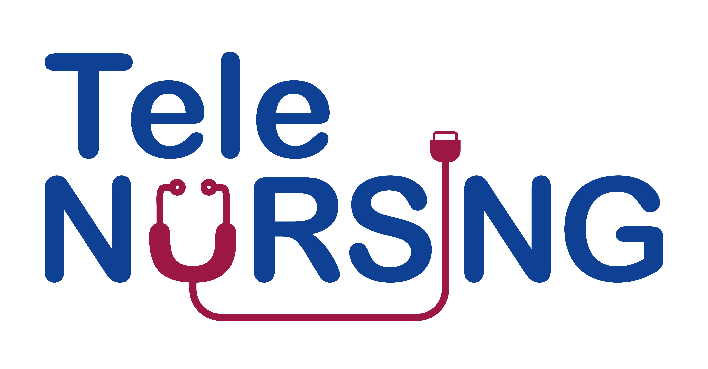
Module 5.0 Managing chronicclinical conditions through telecare Monitoring Processes through Telecare

Slide 2
Monitoring hypertension through telecare
Monitoring hypertension through telecare involves the use of technology to remotely track and manage blood pressure levels in individuals with hypertension. This approach offers a convenient and efficient way to monitor patients while minimizing the need for frequent in-person visits to healthcare facilities.
• Home Blood Pressure Monitoring (HBPM): Patients are equipped with home blood pressure monitors that allow them to measure their blood pressure regularly in the comfort of their own homes. These devices may be traditional arm or wrist cuffs, or newer wearable devices that continuously monitor blood pressure.
• Data Transmission: Patients transmit their blood pressure readings to healthcare providers or monitoring systems using telecommunication technologies. This can be done through secure online platforms, mobile apps, or other telecommunication devices.
• Remote Data Analysis: Healthcare providers or automated systems analyze the transmitted data to track trends, identify potential issues, and make informed decisions regarding the management of hypertension. This analysis may include assessing average blood pressure levels, detecting patterns, and identifying potential triggers for fluctuations.
• Alerts and Notifications: Automated alerts can be set up to notify healthcare providers or patients when there are significant changes in blood pressure readings or if predefined thresholds are exceeded. This allows for timely intervention and adjustment of the treatment plan if necessary.
• Teleconsultations: Telecare may include virtual consultations between patients and healthcare providers through secure video calls. These consultations allow healthcare professionals to discuss blood pressure readings, address concerns, and make adjustments to the treatment plan.
• Integration with Electronic Health Records (EHR): Telecare systems can be integrated with electronic health records to ensure that blood pressure data is seamlessly incorporated into the patient's overall health history. This integration facilitates comprehensive and coordinated care.

Slide 3
Monitoring blood glucose through telecare
Monitoring diabetes through telecare involves using technology to remotely collect and transmit health-related data from individuals with diabetes to healthcare providers for assessment and management. This approach enhances the regular monitoring of blood glucose levels, medication adherence, and other relevant health parameters, promoting timely intervention and personalized care. The monitoring process typically involves several key components:
Continuous Glucose Monitoring (CGM): Telecare systems often incorporate CGM devices that continuously measure glucose levels throughout the day. These devices transmit real-time data to a central monitoring system, allowing healthcare providers to track fluctuations and trends over time.
Smart Glucose Meters: Patients can use smart glucose meters that connect to mobile applications or web platforms. These devices enable individuals to measure their blood glucose levels and automatically upload the results for remote monitoring by healthcare professionals.
Medication Adherence Tracking: Telecare systems may include tools for monitoring medication adherence. Patients can log their medication intake through a mobile app or other devices, providing insights into their treatment compliance.
Activity and Lifestyle Monitoring: Wearable devices and activity trackers can be employed to monitor physical activity, sleep patterns, and other lifestyle factors. This information helps healthcare providers understand the broader context of a patient's health and make more informed decisions.
Teleconsultations: Virtual consultations and video calls allow healthcare providers to communicate with patients remotely. During these sessions, providers can discuss treatment plans, review glucose data, and address any concerns or questions the patient may have.
Data Analytics and Decision Support: Advanced analytics tools analyze the collected data to identify patterns, trends, and potential issues. Decision support systems can assist healthcare providers in making informed decisions about adjusting treatment plans or interventions.
Alerts and Notifications: Telecare systems can generate alerts and notifications for both patients and healthcare providers. These alerts may indicate critical glucose levels, missed medication doses, or other significant events, prompting timely action.

Slide 4
Monitoring heart status conditions through telecare
Monitoring heart failure through telecare involves the use of remote technology to track and assess the health status of individuals with heart failure. This approach can enhance the management of heart failure by providing real-time data to healthcare providers, allowing for early detection of potential issues and timely intervention. Here is an overview of the monitoring process for heart failure through telecare:
Remote Patient Monitoring (RPM): Telecare for heart failure often involves the use of RPM devices that patients can use at home. These devices collect and transmit physiological data to healthcare providers, allowing for continuous monitoring without the need for frequent hospital visits.
Wearable Devices: Patients may use wearable devices such as smartwatches or fitness trackers equipped with sensors to monitor vital signs like heart rate, activity levels, and sometimes even blood pressure. These devices can provide continuous data, and some are capable of sending alerts based on predefined thresholds.
Telehealth Platforms: Patients can communicate with healthcare providers through telehealth platforms. These platforms may include teleconsultations, messaging systems, or secure online portals where patients can report symptoms, ask questions, and receive guidance from healthcare professionals.
Remote Data Transmission: Vital signs and other relevant data collected by RPM devices are transmitted securely to a central monitoring system. This data can include parameters such as heart rate, blood pressure, weight, and oxygen saturation.
Alerts and Notifications: Automated algorithms can be implemented to analyze the transmitted data in real-time. If the system detects any abnormalities or if the patient's condition deviates from the established baseline, it can trigger alerts and notifications for healthcare providers to intervene promptly.
Medication Adherence Monitoring: Telecare solutions can include features to monitor medication adherence. This may involve reminders for patients to take their medications and notifications to healthcare providers if a patient misses doses consistently.
Regular Check-ins: Scheduled virtual visits or check-ins with healthcare providers allow for a comprehensive review of the patient's overall health status, symptomatology, and any concerns they may have.
Data Integration: The collected data can be integrated into the patient's electronic health record (EHR) to provide a comprehensive view of their health history. This integration facilitates better-informed decision-making by healthcare providers.
Care Coordination: Telecare enables better coordination among healthcare providers, ensuring that the entire care team is informed and can collaborate effectively in managing the patient's heart failure.

Slide 5
Monitoring asthma through telecare
Monitoring asthma through telecare involves the use of technology to remotely track and manage asthma symptoms and related data. This approach can provide more timely and personalized care, allowing healthcare providers to intervene when necessary and empowering patients to better manage their condition. Here are key components of the monitoring process for asthma through telecare:
Connected Devices and Sensors:
Smart Inhalers: These devices are attached to standard inhalers and can track medication usage. They record the date and time of each inhalation, providing insights into medication adherence.
Peak Flow Meters: Some digital peak flow meters can connect to smartphones or other devices to measure and record peak expiratory flow (PEF) rates, which can indicate changes in lung function.
Wearable Devices: Fitness trackers or smartwatches may have sensors that can monitor physical activity, sleep patterns, and other relevant data to assess overall well-being.
Mobile Applications: Patients can use mobile apps to log and monitor their asthma symptoms, such as coughing, wheezing, or shortness of breath. These apps may also prompt users to input triggers and environmental factors.
Remote Monitoring Platforms: Data collected from connected devices and mobile apps are often stored in secure cloud platforms. This allows healthcare providers to access real-time information and historical data to track trends and identify potential issues.
Teleconsultations: Healthcare providers can conduct remote consultations with asthma patients to discuss symptoms, review data, and make necessary adjustments to the treatment plan. This helps in providing personalized care without the need for in-person visits.

Slide 6
Monitoring cancer through telecare
The monitoring process of cancer through telecare involves using remote monitoring technologies and communication tools to keep track of a patient's health status, treatment progress, and overall well-being. Telecare allows healthcare providers to collect data and monitor cancer patients without the need for frequent in-person visits. Here are some key components of the monitoring process for cancer through telecare:
Remote Patient Monitoring (RPM): RPM involves the use of medical devices and sensors to collect and transmit patient data to healthcare providers. For cancer patients, this may include devices that monitor vital signs, such as blood pressure, heart rate, temperature, and oxygen saturation.
Telehealth Consultations: Virtual consultations through video calls or phone calls enable healthcare providers to communicate with cancer patients, discuss symptoms, answer questions, and assess overall health. These consultations can be scheduled regularly or on an as-needed basis.
Electronic Health Records (EHRs): EHRs enable the secure storage and exchange of patient information among healthcare providers. Telecare systems often integrate with EHRs, allowing healthcare teams to access and update patient records remotely.
Remote Lab Monitoring: Some telecare systems facilitate remote monitoring of laboratory test results, allowing healthcare providers to track blood counts, tumor markers, and other relevant lab values without the need for in-person visits.
Alert Systems: Telecare platforms may incorporate alert systems that notify healthcare providers of any significant changes or concerning trends in a patient's health data. This allows for timely intervention and adjustments to the treatment plan.

